Slide 1
Normal Forms
Adapted from Chapter 5
Modern Database Management
8th Edition
Jeffrey A. Hoffer, Mary B. Prescott,
Fred R. McFadden
© 2007 by Prentice Hall

Slide 2
Data Normalization
Primarily a tool to validate and improve a logical design so that it satisfies certain constraints that avoid unnecessary duplication of data
The process of decomposing relations with anomalies to produce smaller, well-structured relations

Slide 3
Well-Structured Relations
A relation that contains minimal data redundancy and allows users to insert, delete, and update rows without causing data inconsistencies
Goal is to avoid anomalies
  Insertion Anomaly–adding new rows forces user to create duplicate data
  Deletion Anomaly–deleting rows may cause a loss of data that would be needed for other future rows
  Modification Anomaly–changing data in a row forces changes to other rows because of duplication
General rule of thumb: A table should not pertain to more than one entity type

Slide 4

Example–Figure 5-2b
Question–Is this a relation?
Answer–Yes: Unique rows and no multivalued attributes
Question–What’s the primary key?
Answer–Composite: (Emp_ID, Course_Title)

Slide 5
Anomalies in this Table
Insertion–can’t enter a new employee without having the employee take a class
Deletion–if we remove employee 140, we lose information about the existence of a Tax Acc class
Modification–giving a salary increase to employee 100 forces us to update multiple records
Why do these anomalies exist?
  Because there are two themes (entity types) in this one relation. This results in data duplication and an unnecessary dependency between the entities

Slide 6
A normal form is a state of a relation that results from applying simple rules regarding functional dependencies (or relationships between attributes) to that relation.
First Normal Form.
Second Normal Form.
Third Normal Form.
Boyce/Codd Normal Form.
Fourth Normal Form
Fifth Normal Form

Slide 7
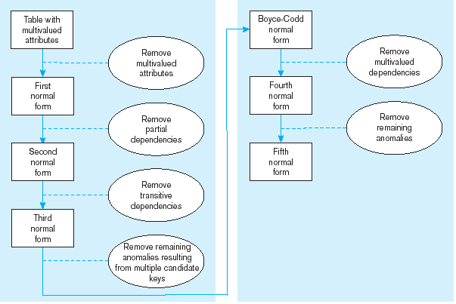
Figure 5.22 Steps in normalization

Slide 8
Functional Dependencies
For any relation R, attribute B is functionally dependent on attribute A if, for every valid instance of A, the value of A uniquely determines the value of B. This dependency is represented by A B. Attribute A is called a determinant.
Examples:
SSN Name, Address, Birthdate
ISBN Title, First_Author_Name
EMP_COURSE (Emp_ID, Course_Name, Date_Completed)
Emp_ID, Course_Name Date_Completed.

Slide 9
Candidate Key
A candidate key is an attribute, or combination of attributes, that uniquely identifies a row in a relation. If one relation has more than one candidate keys, one of those keys will become the primary key. A candidate key must satisfy:
Unique identification. For every row, the value of the key must uniquely identify that row. This implies that in a well-structured relation, each non-key attribute is functionally dependent on that key.
Non-redundancy. No attribute in the key can be deleted without destroying the property of unique identification.

Slide 10
Consider the following EMPLOYEE1 relation:
EMPLOYEE1 (Emp_ID, Name, Dept_Name, Salary)
Emp_ID is the only determinant in this relation. All of the other attributes are functionally dependent on Emp_ID. Thus, Emp_ID is a candidate key and, since there are no other candidate keys, also is the primary key.
EMPLOYEE1
Emp_ID
Name
Dept_Name
Salary

Slide 11
Consider: EMPLOYEE2 (Emp_ID, Crs_Title, Name, Dept_Name, Salary, Completed)
Neither Emp_ID nor Crs_Title by itself uniquely identifies a row in this relation. There are 2 functional dependencies in this relation:
Emp_ID Name, Dept_Name, Salary
Emp_ID, Crs_Title Completed.
The combination of Emp_ID and Crs_Title does uniquely identify each row in EMPLOYEE2. Thus, Emp_ID and Crs_Title, together, is a candidate key (and also the primary key of EMPLOYEE2). Note, however, not every non-key attribute is dependent on the full set of key! This can create insertion, deletion, and modification anomalies (more on these later).
EMPLOYEE2
Emp_ID | Crs_Title | Name | Dept_Name | Salary | Completed

Slide 12
First Normal Form
No multivalued attributes
Every attribute value is atomic
Fig. 5-25 is not in 1st Normal Form (multivalued attributes) ➔ it is not a relation
Fig. 5-26 is in 1st Normal form
All relations are in 1st Normal Form

Slide 13
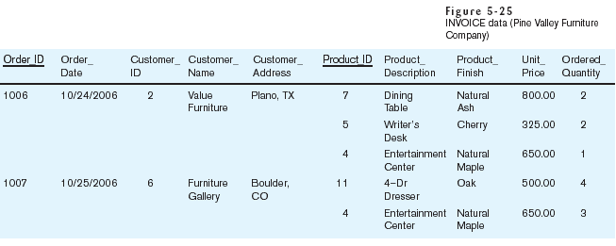
Table with multivalued attributes, not in 1st normal form
Note: this is NOT a relation

Slide 14
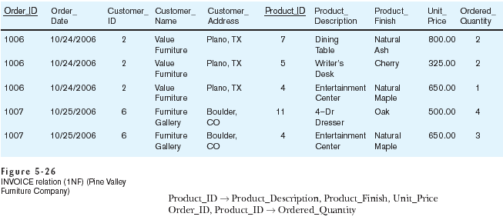
Table with no multivalued attributes and unique rows, in 1st normal form
Note: this is relation, but not a well-structured one

Slide 15
Anomalies in this Table
Insertion–if new product is ordered for order 1007 of existing customer, customer data must be re-entered, causing duplication
Deletion–if we delete the Dining Table from Order 1006, we lose information concerning this item's finish and price
Update–changing the price of product ID 4 requires update in several records
Why do these anomalies exist?
  Because there are multiple themes (entity types) in one relation. This results in duplication and an unnecessary dependency between the entities

Slide 16
Second Normal Form
A relation that is in first normal form will be in second normal form if anyone of these conditions applies:
The primary key consists of only one attribute (such as the attribute Emp_ID in EMPLOYEE1).
No non-key attributes exist in the relation (thus all of the attributes in the relation are components of the primary key).
Every non-key attribute is functionally dependent on the full set of primary key attributes.

Slide 17
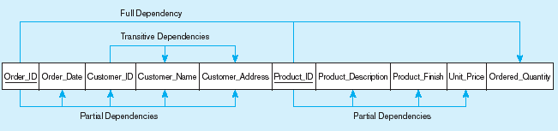
Figure 5-27 Functional dependency diagram for INVOICE
Order_ID ➔ Order_Date, Customer_ID, Customer_Name, Customer_Address
Customer_ID ➔ Customer_Name, Customer_Address
Product_ID ➔ Product_Description, Product_Finish, Unit_Price
Order_ID, Product_ID ➔ Order_Quantity
Therefore, NOT in 2nd Normal Form

Slide 18
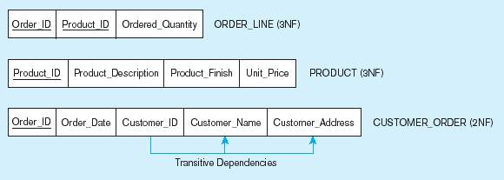
Figure 5-28 Removing partial dependencies
Getting it into Second Normal Form
Partial dependencies are removed, but there are still transitive dependencies

Slide 19
Third Normal Form
2NF PLUS no transitive dependencies (functional dependencies on non-primary-key attributes)
Note: This is called transitive, because the primary key is a determinant for another attribute, which in turn is a determinant for a third
Solution: Non-key determinant with transitive dependencies go into a new table; non-key determinant becomes primary key in the new table and stays as foreign key in the old table

Slide 20
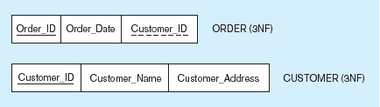
Figure 5-28 Removing partial dependencies
Getting it into Third Normal Form
Transitive dependencies are removed

Slide 21
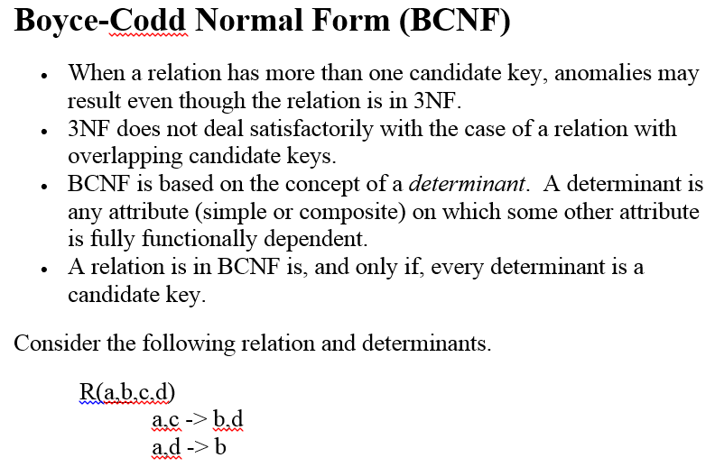
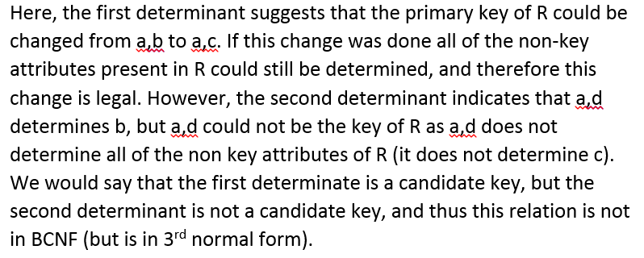

Slide 22
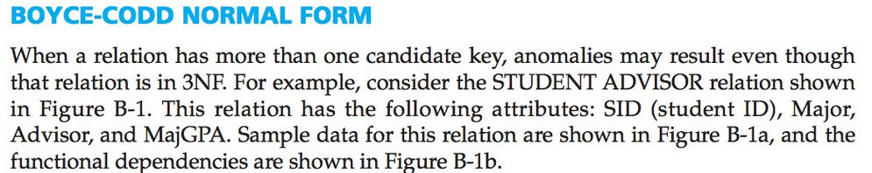
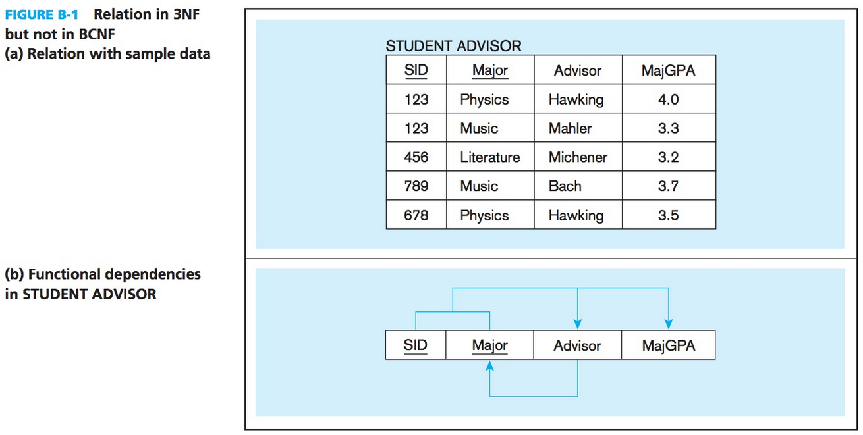

Slide 23
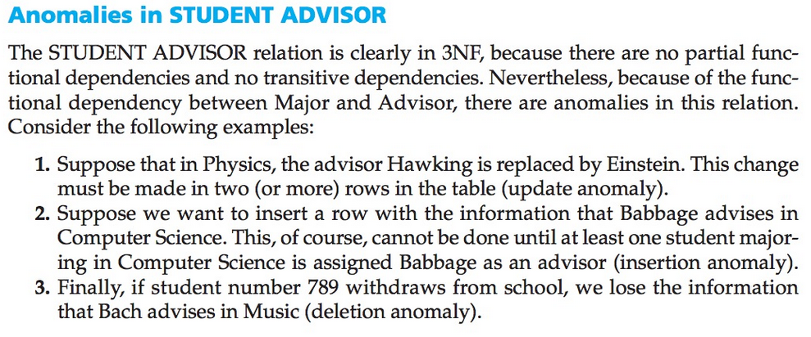
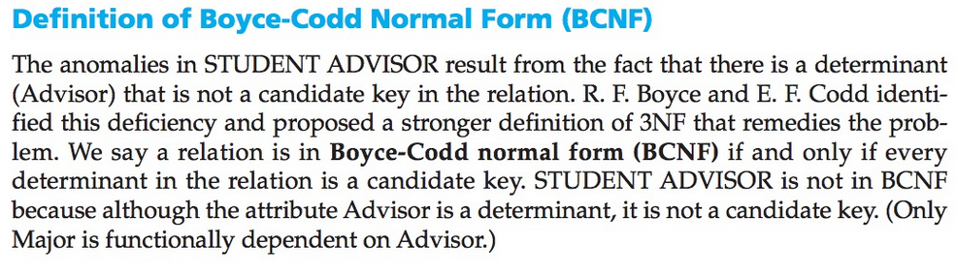

Slide 24
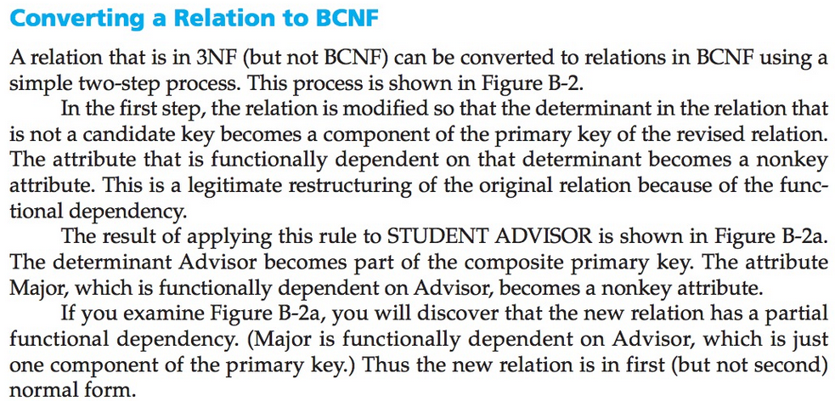
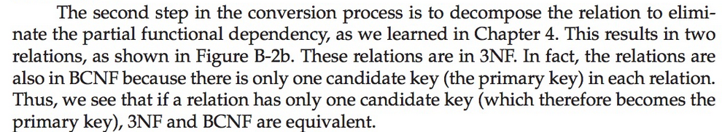

Slide 25
